Slide 1
Arrays
Qurra-tul-ann
Lecturer

Slide 2
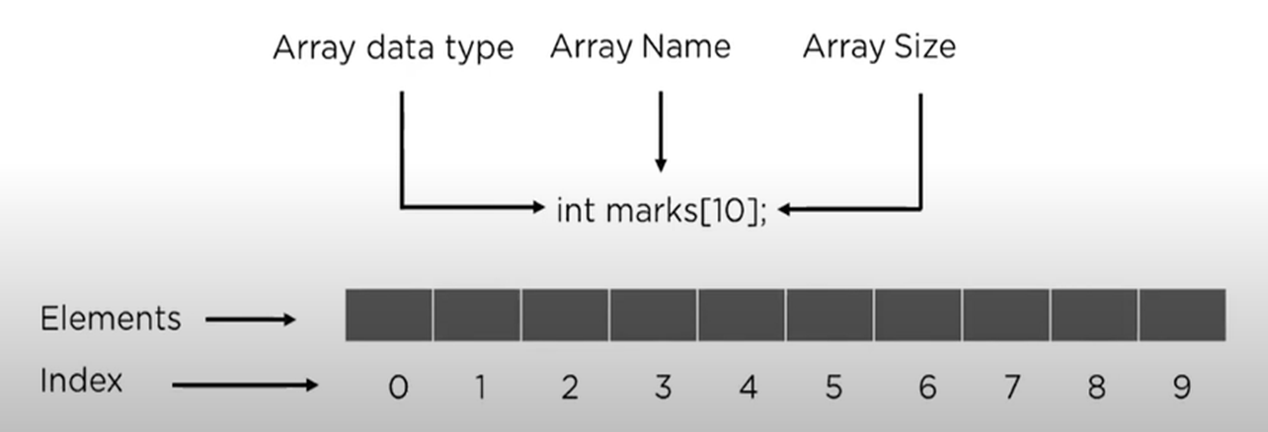
Array
Array is a container which can hold fix number of items and these items should be of same type. Most of the data structure make use of array to implement their algorithms.
Following are important terms to understand the concepts of Array.
Element − Each item stored in an array is called an element.
Index − Each location of an element in an array has a numerical index which is used to identify the element.
Consider following program for Array declaration and its representation in memory
main( )
{
int x[10]={35,33,42,10,14,19,27,44,26,31};
int j;
for(j = 0; j < 6; j++)
x[j] = 2 * j;
}
Notes:
x[0] = 0, x[1] = 2, x[2] = 4, x[3] = 6, x[4] = 8, x[5] = 10, x[6] = 27

Slide 3
Array Declaration/Initialization
Declaration :
int a[20], b[3],c[7];
float f[5], c[2];
char m[4], n[20];
Initialization :
float, b[3]={2.0, 5.5, 3.14};
char name[4]= {‘E’,’m’,’r’,’e’};
int c[10]={0};
int a[]={1,2,3,4,5};
Int a[3]; a[0]=1; a[1]=1; a[2]=2;

Slide 4
ACCESSING ELEMENT OF THE ARRAY
TO access array element :
a[5];
Operations on array:
traversal
insertion
Deletion
searching
sorting

Slide 5
TRAVERSAL
#include <iostream>
using namespace std;
#define size 10 // another way int const size = 10
int main(){
int x[10]={4,3,7,-1,7,2,0,4,2,13}, i, sum=0,LB=0, UB=size;
float av;
for(i=LB;i<UB;i++)
{ sum = sum + x[i];
av = (float)sum/size;
cout<< "The average of the numbers= "<<av<<endl;
}
return 0;
}

Slide 6
INSERT
void insertElement(int arr[], int &size, int pos, int element) {
if (pos > size || pos < 0) {
cout << "Invalid Position!" << endl;
return;
}
for (int i = size; i > pos; i--) { // Shift elements to the right
arr[i] = arr[i - 1];
}
arr[pos] = element; // Insert the new element
size++; // Increase size
for (int i = 0; i < size; i++) { // Print updated array
cout << arr[i] << " ";
}
cout << endl;
}

Slide 7
int main() {
int arr[10] = {1, 2, 3, 5, 6}; // Initial array
int size = 5; // Current size
int element = 4, position = 3; // Insert 4 at index 3
insertElement(arr, size, position, element);
return 0;
}

Slide 8
Update
void update(int arr[], int size, int index, int newValue) {
if (index < 0 || index >= size) {
cout << "Invalid index!" << endl;
return;
}
arr[index] = newValue;
}

Slide 9
Deletion
void deleteElement(int arr[], int &size, int pos) {
if (pos >= size || pos < 0) {
cout << "Invalid Position!" << endl;
return;
}
for (int i = pos; i < size - 1; i++) {// Shift elements to the left
arr[i] = arr[i + 1];
}
size--; // Reduce size
for (int i = 0; i < size; i++) { // Print updated array
cout << arr[i] << " ";
}
cout << endl;
}

Slide 10
int main() {
int arr[10] = {1, 2, 3, 4, 5};
int size = 5; // Current size
int position = 2; // Delete element at index 2 (value = 3)
deleteElement(arr, size, position);
return 0;
}

Slide 11
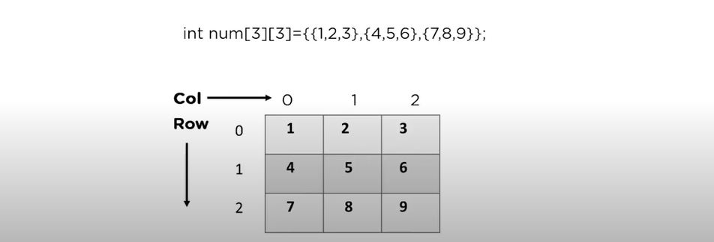
2-D Array
The two dimensional (2D) array is also known as matrix.
A matrix can be represented as a table of rows and columns.

Slide 12
Display a matrix
#include <iostream>
using namespace std;
int main() {
int x[3][3]={{3,4,5},
{6,7,8},
{9,1,2}};
for(int i = 0; i< 3; i++)
{
for(int j = 0; j< 3; j++)
{
cout<<x[i][j];
}
cout<<"\n";
}
}

Slide 13
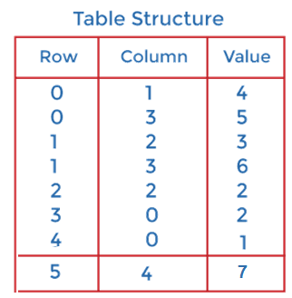
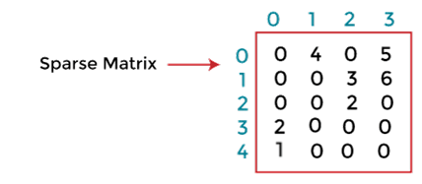
Sparse Matrix
It is a matrix in which most of the elements are zero. To efficiently store and manipulate a sparse matrix, we use a compressed storage format such as a 3-column representation (row, column, value).
Why to use Sparse Matrix instead of simple matrix ?
Storage: There are lesser non-zero elements than zeros and thus lesser memory can be used to store only those elements.
Computing time: Computing time can be saved by logically designing a data structure traversing only non-zero elements..
2D array is used to represent a sparse matrix in which there are three rows named as
Row: Index of row, where non-zero element is located
Column: Index of column, where non-zero element is located
Value: Value of the non zero element located at index – (row, column)

Slide 14
EXAMPLE:
#include<iostream>
using namespace std;
int main () {
int a[10][10] = { {0, 0, 9} , {5, 0, 8} , {7, 0, 0} };
int i, j, count = 0;
int row = 3, col = 3;
for (i = 0; i < row; ++i) {
for (j = 0; j < col; ++j){
if (a[i][j] == 0)
count++;
}
}
cout<<"The matrix is:"<<endl;
for (i = 0; i < row; ++i) {
for (j = 0; j < col; ++j) {
cout<<a[i][j]<<" ";
}
cout<<endl;
}
cout<<"The number of zeros in the matrix are "<< count <<endl;
if (count > ((row * col)/ 2))
cout<<"This is a sparse matrix"<<endl;
else
cout<<"This is not a sparse matrix"<<endl;
return 0;
}

Slide 15
Issues with Array
Want to use an array data structure but may lack the information about the size of the array at compile time
For example you have to store telephone directory or store the names of total population of a city or a country
If you initially assign a very large chunk of memory and store very few information what will happen?
If you initially store very small chunk of memory and your requirement increases with the passage of time – what will happen?
Misuse of resource
What are the possible solutions?

Slide 16
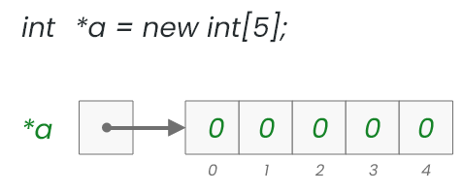
Dynamic Array
Dynamic array allocation is actually a combination of pointers and dynamic memory allocation.
Dynamic arrays are created in the heap using the new and released from the heap using delete operators.
int* y = new int[20];
Computer will allocate twenty memory location at the time of execution.
The new key word returns the memory address of first of twenty locations and store that address into y.
Use following statement to release memory because y is allocated memory using new
delete[] y;
Notes:
Not deallocating memory can lead to memory leaks, causing performance issues and even crashing your program.

Slide 17
EXAMPLE:
#include<iostream>
using namespace std;
int main() {
int x, n;
cout << "Enter the number of items:" << "\n";
cin >>n;
int *arr = new int[n];
cout << "Enter " << n << " items" << endl;
for (x = 0; x < n; x++) {
cin >> arr[x];
}
cout << "You entered: ";
for (x = 0; x < n; x++) {
cout << arr[x] << " ";
}
delete [] arr;; // freeing-up space
return 0;
}

Slide 18
DYNAMIC ALLOCATION USING VECTORS
#include <iostream>
#include <vector>
using namespace std;
int main() {
int size;
cout << "Enter the size of the array: ";
cin >> size;
vector<int> arr(size); // Create dynamic array using vector
cout << "Enter " << size << " elements: "; // Taking input
for (int i = 0; i < size; i++) {
cin >> arr[i];
}
cout << "Array elements: "; // Display array
for (int num : arr) {
cout << num << " ";
}
cout << endl;
return 0;
}

Slide 19
ASYMPTOTIC ANALYSIS
Used to describe the growth of functions in terms of input size (n).
Asymptotic notation is a shorthand way to represent the time complexity.
Compares different algorithms effectively.
Types of Asymptotic Notation
Big-O (O) – Upper bound (worst-case).
Omega (Ω) – Lower bound (best-case).
Theta (Θ) – Tight bound (average-case).

Slide 20
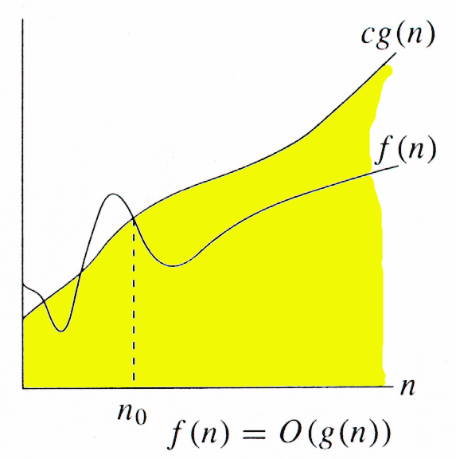
Big-O Notation (O): Worst –case
Definition:
O(g(n)) represents an upper bound on the growth rate of a function f(n). There exist positive constants c and n₀ such that f(n) ≤ c * g(n) for all n ≥ n₀.
Explanation: function g(n) is an upper bound for function f(n), as g(n) grows faster than f(n).
Example:
f(n) = 2n² + 5n + 1
g(n) = n²
We can find c=3 and n₀=1
such that 2n² + 5n + 1 ≤ 3n² for all n ≥ 1.
Therefore, f(n) is O(n²).
Notes:
The above expression can be described as a function f(n) belongs to the set O(g(n)) if there exists a positive constant c such that it lies between 0 and cg(n), for sufficiently large n.
f(n) represents the function being analyzed, typically the algorithm’s time complexity.
g(n) represents a specific function that bounds f(n).
C, C1​, and C2​ are constants.
n₀​ is the minimum input size beyond which the inequality holds.

Slide 21
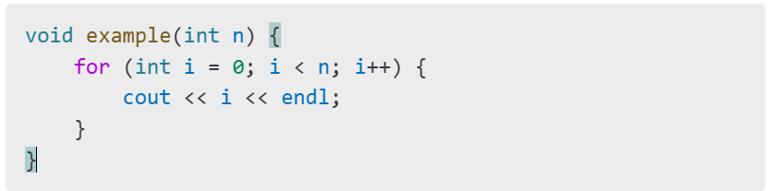
Big-O Notation (O)
Example:
Complexity: O(n) (Linear Time)

Slide 22
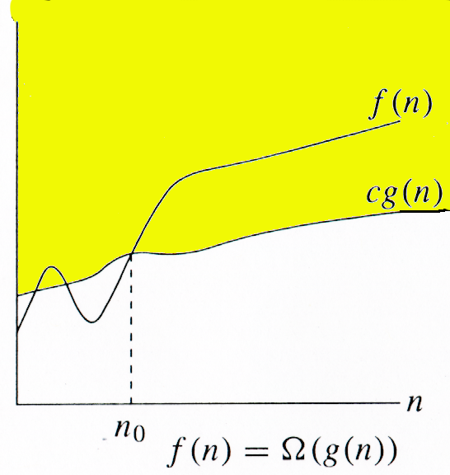
Omega Notation (Ω): Best-case
Definition:
Ω(g(n)) represents a lower bound on the growth rate of a function f(n). There exist positive constants c and n₀ such that c * g(n) ≤ f(n) for all n ≥ n₀.
Explanation: It means function g is a lower bound for function f ; after a certain value of n, f will never go below g..
Example:
f(n) = n³ - 2n
g(n) = n³
c=1/2 and n₀=2
(1/2)n³ ≤ n³ - 2n for all n ≥ 2.
Therefore, f(n) is Ω(n³).
Notes:
The above expression can be described as a function f(n) belongs to the set Ω(g(n)) if there exists a positive constant c such that it lies above cg(n), for sufficiently large n.
For any value of n, the minimum time required by the algorithm is given by Omega Ω(g(n)).

Slide 23
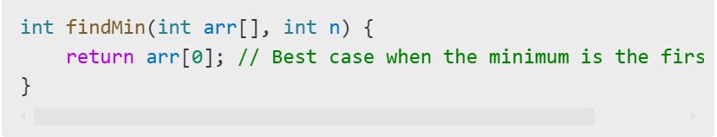
Example:
Complexity: Ω(1) (Constant Time)

Slide 24
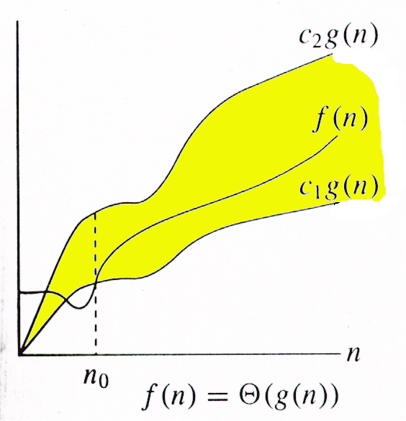
Theta Notation (Θ): Average case
Definition:
Θ(g(n)) represents both an upper and lower bound i.e (tight bound)on the growth rate of a function f(n). There exist positive constants c₁, c₂, and n₀ such that c₁ * g(n) ≤ f(n) ≤ c₂ * g(n) for all n ≥ n₀.
Explanation: f(n) grows at the same rate as g(n) (up to constant
factors) for sufficiently large inputs.
Example:
f(n) = 3n² + 7n - 2
g(n) = n²
We can find c₁=3/2, c₂=5 and n₀=7
(3/2)n² ≤ 3n² + 7n - 2 ≤ 5n² for all n ≥ 7.
Therefore, f(n) is Θ(n²).
Notes:
The above expression can be described as a function f(n) belongs to the set Θ(g(n)) if there exist positive constants c₁ and c₂ such that it can be sandwiched between c₁g(n) and c₂g(n), for sufficiently large n.
If a function f(n) lies anywhere in between c₁g(n) and c₂g(n) for all n ≥ n0, then f(n) is said to be asymptotically tight bound.

Slide 25
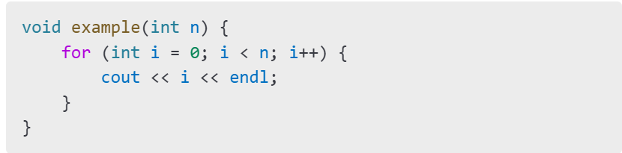
Theta Notation (Θ)
Complexity: Θ(n) (Linear Time)

Slide 26
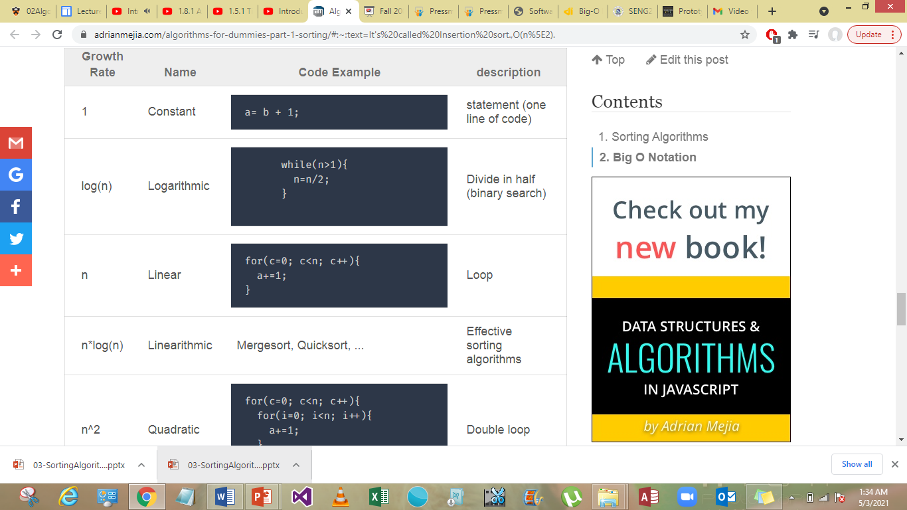
Common Complexity Classes

Slide 27
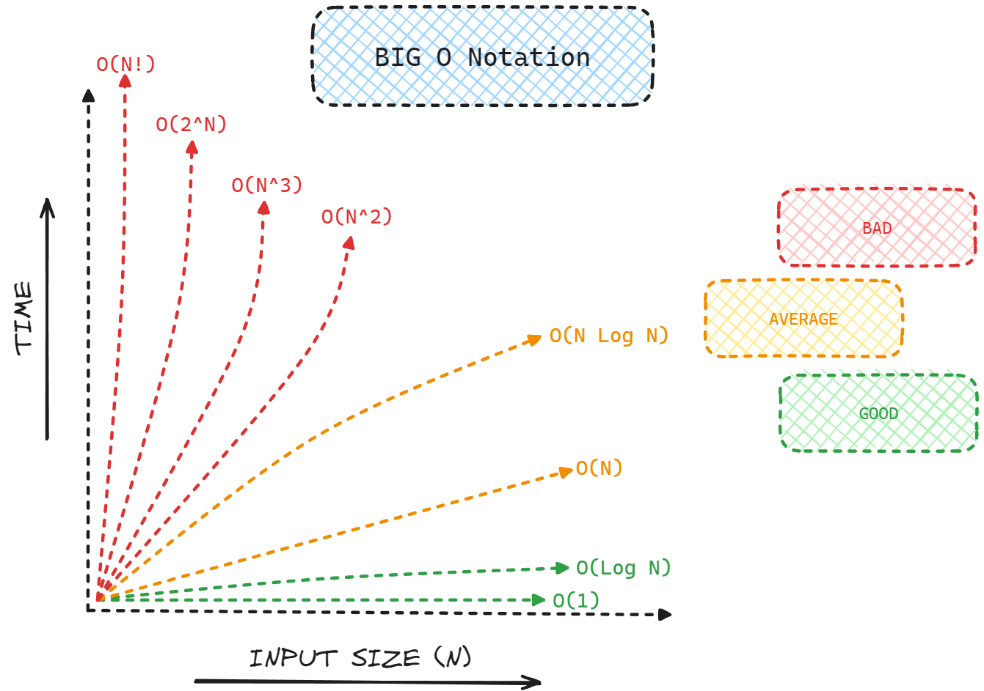
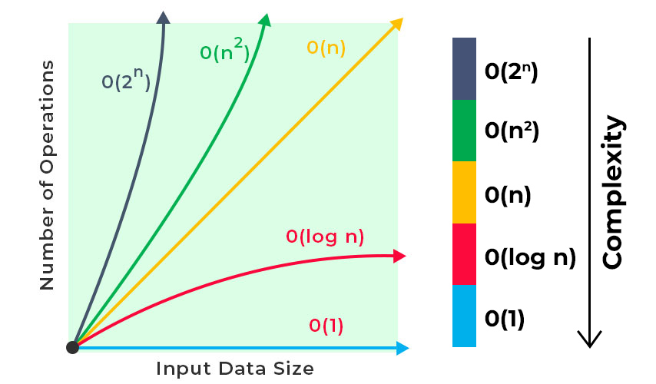

Slide 28
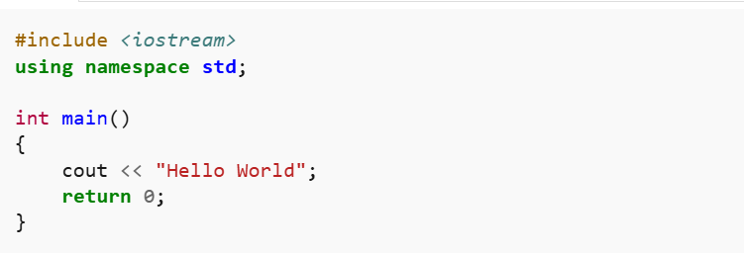
Constant Time Complexity - O(1)
If the method's time does not vary and remains constant as the input size increases, the algorithm is said to have O(1) complexity.
The algorithm is not affected by the size of the input.
It takes a fixed number of steps to complete a particular operation
time complexity is constant: O(1) i.e. every time a constant amount of time is required to execute code

Slide 29
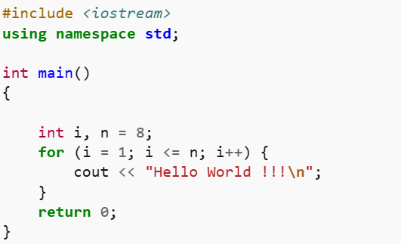
Linear Time Complexity - O(n)
Linear time complexity O(n) means that the algorithms take proportionally longer to complete as the input grows.
To execute an operation on N items it takes about the same number of steps as the number of elements
“Hello World !!!” is printed only n times . So it is O(n)

Slide 30
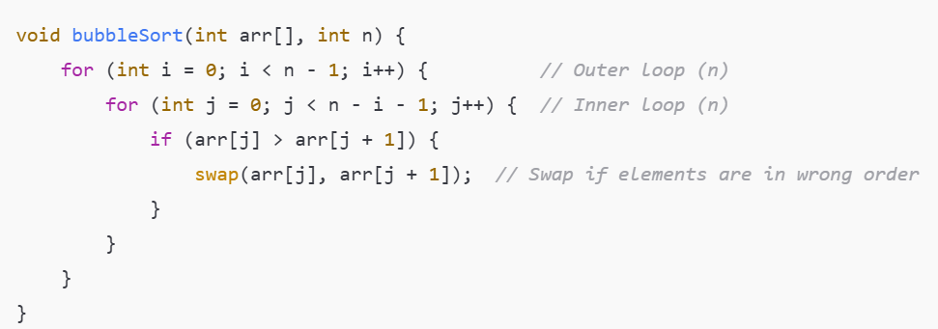
Quadratic Time Complexity - O(n2)
A method for input size n (where n is very large) executes almost double (n2) the steps, and the algorithm's time changes.
For a particular operation, it takes on the order of N2 steps, where N is the size of the input data. Eg: If the input is size 2, it will do four operations. If the input is size 8, it will take 64, and so on

Slide 31
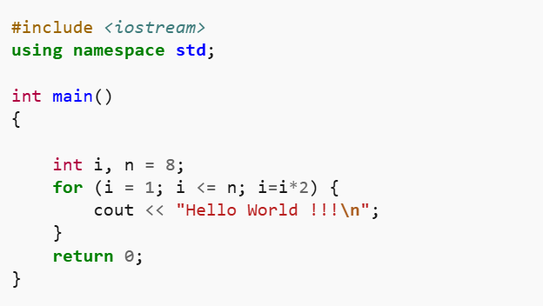
Logarithmic Time Complexity - O(log n)
When the algorithm runtime increases very slowly compared to an increase in input size
Logarithmic time complexities usually apply to algorithms (where n is really big) that divide problems in half for each iteration (log n).
It takes log(N) steps to execute a particular operation on N items, where the logarithm base is usually 2
Time Complexity: O(log₂(n))
Notes:
Log2(8)=3

Slide 32
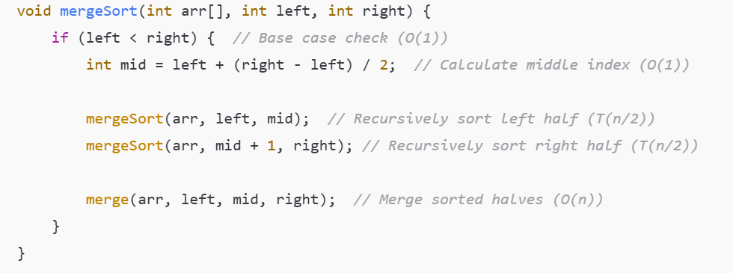
O(n log n) Time Complexity
An algorithm with an O(n log n) complexity (where n is really big) divides the issue into little chunks for each invocation, then takes each of the smallest bits and stitches them back together (n log n).
generally seen in sorting algorithms like Quick sort, Merge Sort, Heap sort. Here N is the size of data structure (array) to be sorted and log N is the average number of comparisons needed to place a value at its right place in the sorted array.

Slide 33
How Merge Sort Works?
Divide: The array is split in half again and again until each part contains only one element (because a single element is already sorted).
Conquer: Each small part is sorted individually.
Merge: The sorted parts are combined back into a single sorted array.
Time complexity :
Every time we split the array, we divide it into two halves.
depth of recursion (number of splits) is log n (becz we keep dividing by 2).
At each level of recursion, we merge n elements back together.
Since there are log n levels, and each level takes O(n) time, the total time is O(n log n).

Slide 34
Merge Sort Analysis
Merge n items:
O(n)
n
Level 0
n/2
n/2
Level 1
Merge two n/2 items:
O(n)
n/4
n/4
n/4
n/4
Level 2
Each level requires
O(n) operations
. . .
1
1
1
1
1
1
Tree Height : log₂n
Each level O(n) operations & O(log₂n) levels → O(n*log₂n)
Notes:
Merge Sort is quite fast, and has a time complexity of O(n*log n). It is also a stable sort, which means the "equal" elements are ordered in the same order in the sorted list.
Here, we will understand why the running time for merge sort is O(n*log n).?
As we have already learned in Binary Search that whenever we divide a number into half in every step, it can be represented using a logarithmic function, which is log n and the number of steps can be represented by log n + 1(at most)
Also, we perform a single step operation to find out the middle of any subarray, i.e. O(1).
And to merge the subarrays, made by dividing the original array of n elements, a running time of O(n) will be required.
Hence the total time for mergeSort function will become n(log n + 1), which gives us a time complexity of O(n*log n).

Slide 35
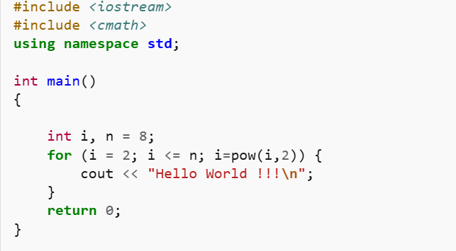
Example 5
Time Complexity: O(log(log n))
Notes:
"Hello World !!!" is printed twice.
i grows exponentially (i² each time) i.e 2, 4, 16, ...
Growth rate: O(log log n), because i is squared in each step.

Slide 36
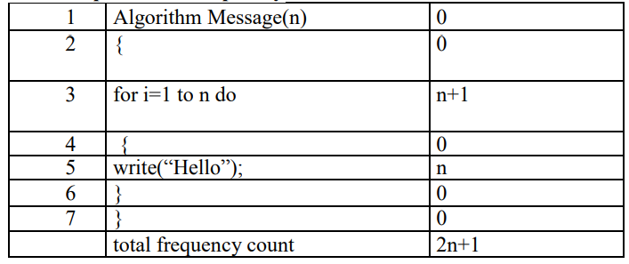
Finding the complexities
While computing the time complexity we will neglect all the constants, hence ignoring 2 and 1 we will get n. Hence the time complexity becomes O(n).

Slide 37
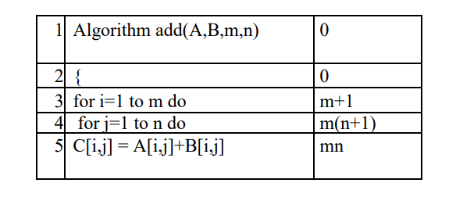

Finding the complexities
f(n) = Og(n). => O(2mn+2m+1)// when m=n; = O(2n2 +2n+1); By neglecting the constants, we get the time complexity as O(n2 ). The maximum degree of the polynomial has to be considered

Slide 38
Computational Complexity of Linear Search
It is the maximum number of comparisons you need to search the array. As you are
visiting all the array elements in the worst case, then, the number of
comparisons required is:
n (n is the size of the array)
Example:
If a given an array of 1024 elements, then the maximum number of
comparisons required is:
n-1 = 1023 (As many as 1023 comparisons may be required)

Slide 39
Computational Complexity of Binary Search
The searched array is divided by 2 for each comparison/iteration.
Therefore, the maximum number of comparisons is measured by:
log2(n) where n is the size of the array
Example:
If a given sorted array 1024 elements, then the maximum number of
comparisons required is:
log2(1024) = 10 (only 10 comparisons are enough)
Notes:
E.g. If the array’s length is 8, then we the while loop will execute 3 times because log₂(8) = 3.

Slide 40
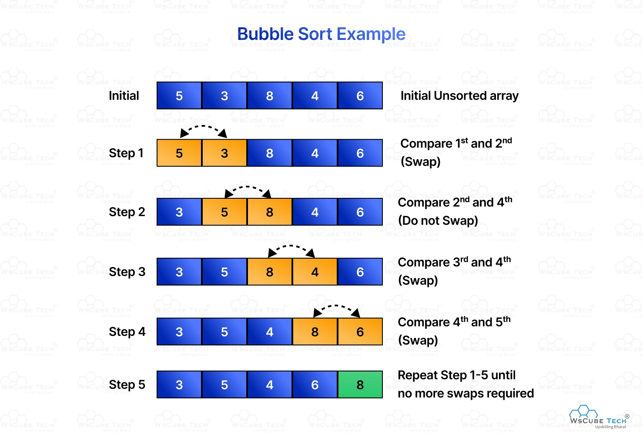
Bubble Sort
Idea:
Repeatedly pass through the array
Swaps adjacent elements that are out of order
Easier to implement, but slower than Insertion sort

Slide 41
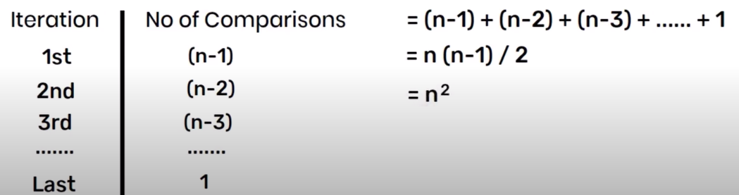
Algo of bubble sort
BubbleSort(A)
n = Length[A];
for j = 0 to n-2
for i = 0 to n-j-2
if A[i] > A[i+1]
temp = A[i]
A[i] = A[i+1]
A[i+1] = temp
return A;
Notes:
Best case : ascending ,no swap ,n-1 comparison -> o(n)
Worst case : descending , n-1 swap , n-1 comparison -> o(n) : n(n-2)/2 -> o(n^2)

Slide 42
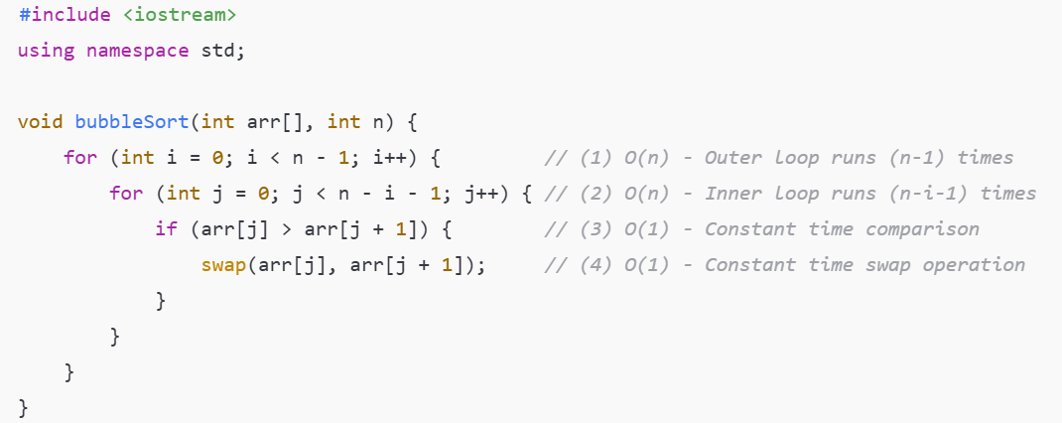
BUBBLE SORT
}
}

Slide 43
Bubble-Sort Running Time
Alg.: BUBBLESORT(A)
for i ← 1 to length[A]
do for j ← length[A] downto i + 1
do if A[j] < A[j -1]
then exchange A[j] ↔ A[j-1]
c₁
c₂
Comparisons: ≈ n²/2
c₃
c₄
Exchanges: ≈ n²/2
T(n) =
c₁(n+1) +
c₂
c₃
c₄
= Θ(n) +
(c₂ + c₂ + c₄)
Thus,T(n) = Θ(n²)
Notes:
Best-Case Time Complexity: O(n). The array is already sorted.
Average Time Complexity: O(n²)
Worst-Case Time Complexity: O(n²) (The array is in reverse sorted order

Slide 44
Insertion Sort
Insertion Sort
we start from 2 elemet as e considered ist elemet is sorted
Idea: like sorting a hand of playing cards
Start with an empty left hand and the cards facing down on the table.
Remove one card at a time from the table, and insert it into the correct position in the left hand
compare it with each of the cards already in the hand, from right to left
The cards held in the left hand are sorted
these cards were originally the top cards of the pile on the table

Slide 45
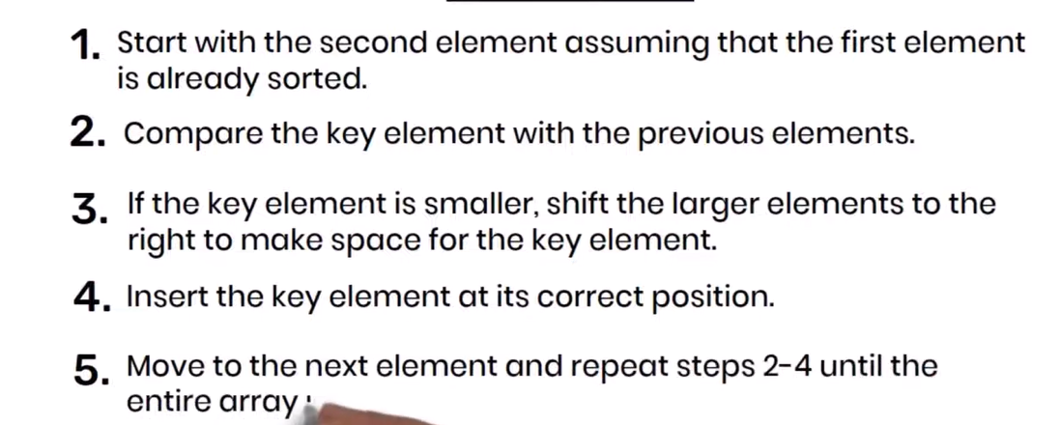
Algo

Slide 46
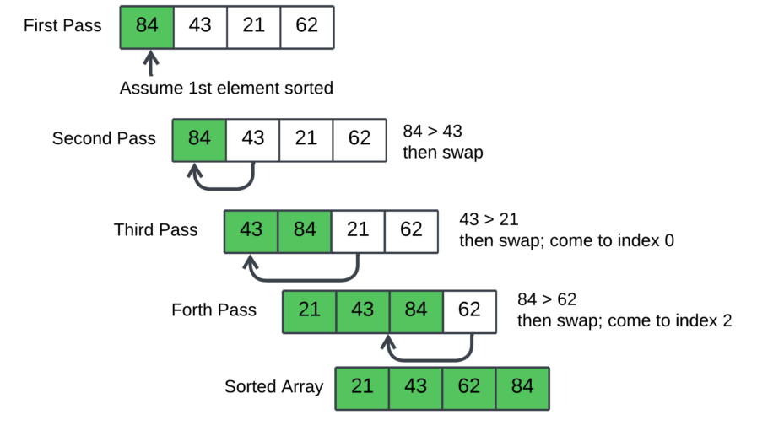
Insertion Sort

Slide 47
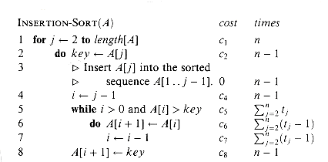
Algo
Notes:
Best case: O(n), If the list is already sorted, where n is the number of elements in the list.
Average case: O(n²), If the list is randomly ordered
Worst case: O(n²), If the list is in reverse order

Slide 48
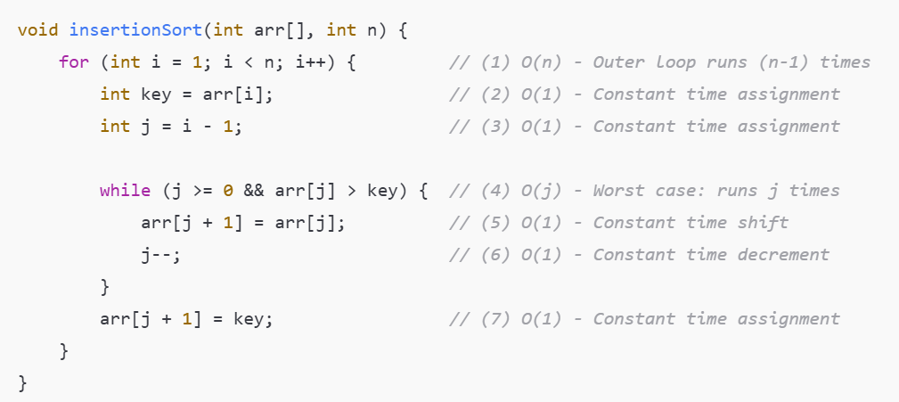
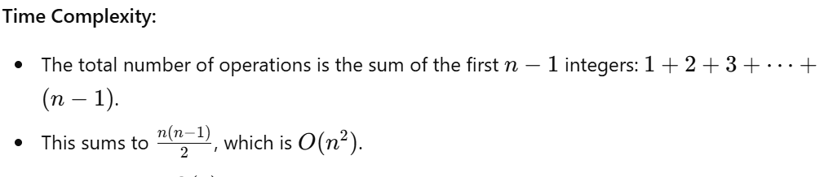
INSERTION SORT

Slide 49
Selection Sort
Idea:
Find the smallest element in the array
Exchange it with the element in the first position
Find the second smallest element and exchange it with the element in the second position
Continue until the array is sorted
Disadvantage:
Running time depends only slightly on the amount of order in the file

Slide 50
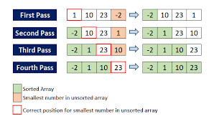
Selection Sort

Slide 51
Analysis of Selection Sort
cost times
c₁ 1
c₂ n
c₃ n-1
c₄
c₅
c₆
c₇ n-1
Alg.: SELECTION-SORT(A)
n ← length[A]
for j ← 1 to n - 1
do smallest ← j
for i ← j + 1 to n
do if A[i] < A[smallest]
then smallest ← i
exchange A[j] ↔ A[smallest]
n²/2
comparisons
n
exchanges
Notes:
For an array of size N, the first pass requires N-1 comparisons, the second pass requires N-2, and so on.This results in the sum: (N−1)+(N−2)+(N−3)+...+2+1=N(N−1)/2. Since N² grows faster than N, we simplify this to O(N²).

Slide 52
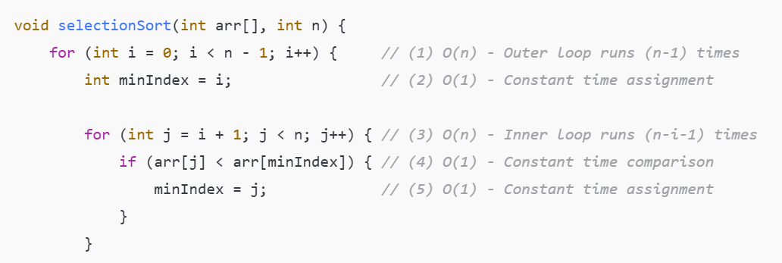
Selection Sort
Notes:
Best-case: O(n²), best case occurs when the array is already sorted.
Average-case: O(n²), the average case arises when the elements of the array are in a disordered or random order, without a clear ascending or descending pattern.
Worst-case: O(n²), The worst-case scenario arises when we need to sort an array in ascending order, but the array is initially in descending order.

